Slide 1
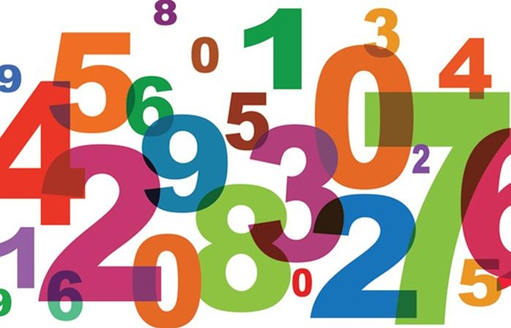
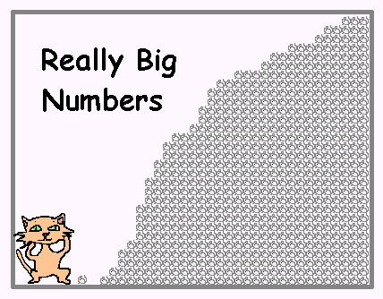
Question
What’s your favorite big number?

Slide 2
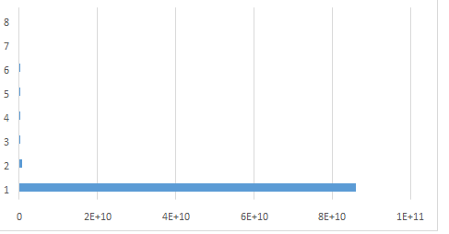
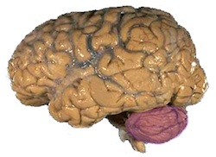
Cells
The average human brain has about 100 billion neurons (nerve cells)
Jellyfish: 800
Snail: 11,000
Fruit Fly: 100,000
Ant: 250,000
Honey Bee: 960,000
Rat: 200,000,000
Cat: 760,000,000
Human: 86,000,000,000 (10¹¹)
Elephants 257,000,000,000 (10¹²)
The average human brain has about 10¹⁵ synapses
Rat: 10¹¹
Cat: 10¹³
Human: 10¹⁵

Slide 3
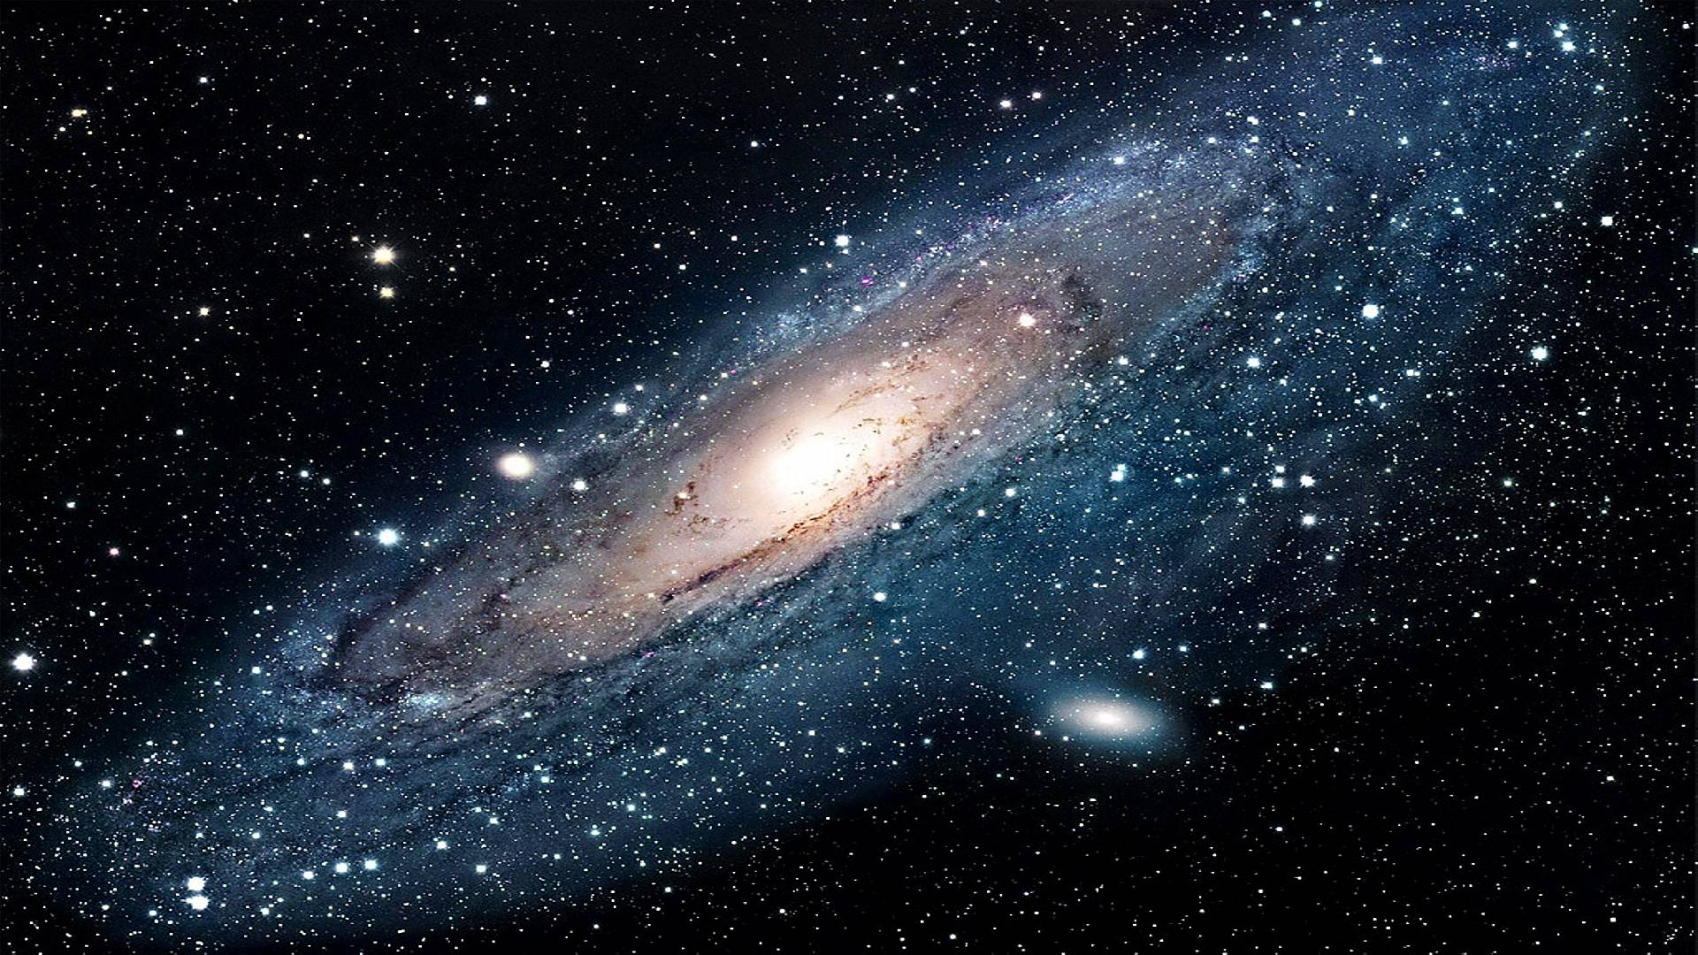
Stars
Stars in the Milky Way: 200 billion stars
Galaxies in the Universe: 100 billion galaxies

Slide 4
Of Humans, Galaxies and Atoms
Atoms in the Universe: ~10⁸⁰
Only accounts only for the observable universe which reaches 46 billion light years in any direction, and is based on where the expansion of space has taken the most distant objects observed
Within this observable universe, this matter is spread homogeneously throughout space, at least when averaged over distances longer than 300 million light-years
On smaller scales, however, matter is observed to form into the clumps of hierarchically-organized luminous matter that we are all familiar with
most atoms are condensed into stars, most stars are condensed into galaxies, most galaxies into clusters, most clusters into superclusters and, finally, into the largest-scale structures like the Great Wall of galaxies

Slide 5
Big Numbers
Million (Mega): 10⁶
A book of zeroes (400 pages with 50 lines per page and 50 zeroes per line)
Billion (Giga): 10⁹
Trillion (Tera): 10¹²
Quadrillion (Peta): 10¹⁵
Quintillion (Exa): 10¹⁸
Sextillion (Zeta): 10²¹
Septillion (Yotta): 10²⁴
Googol: 10¹⁰⁰
Googolplex: 10^{googol}
Neurons in a human brain/Stars in the Milky Way
How many $ greeks owe/Your Wikipedia Lab
How many $ americans owe
Human neurons on Earth
Stars in the Universe
Atoms in the Universe
10,001st Primonacci number

Slide 6
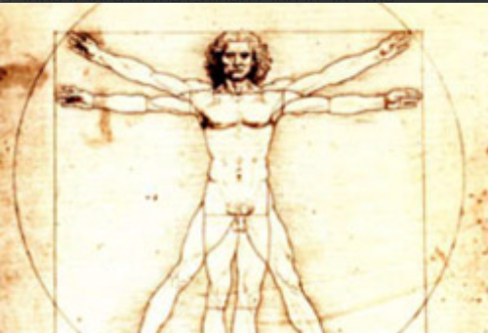
Golden Ratio
Historically, the number can be seen in the architecture of many ancient creations, like the Great Pyramids and the Parthenon
In the Great Pyramid of Giza, the length of each side of the base is 756 feet with a height of 481 feet. The ratio of the base to the height is roughly 1.5717, which is close to the Golden ratio
These numbers can be applied to the proportions of a rectangle, called the Golden rectangle. This is known as one of the most visually satisfying of all geometric forms

Slide 7
Golden Ratio
Two quantities are in the golden ratio if their ratio is the same as the ratio of their sum to the larger of the two quantities

Slide 8
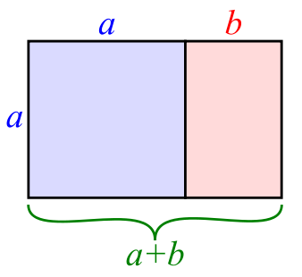
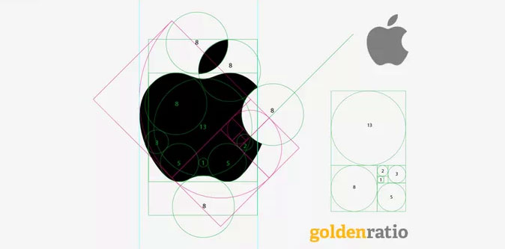
Golden Ratio in Design
a/b = (a+b)/a

Slide 9
Golden Ratio in nature
The number of petals on some flowers or seeds in sunflowers follows the Fibonacci sequence..
It is believed that in Darwinian processes, each petal is placed to allow for the best possible exposure to sunlight and other factors
The measurement of the human navel to the floor and the top of the head to the navel is the Golden ratio
http://io9.gizmodo.com/5985588/15-uncanny-examples-of-the-golden-ratio-in-nature

Slide 10
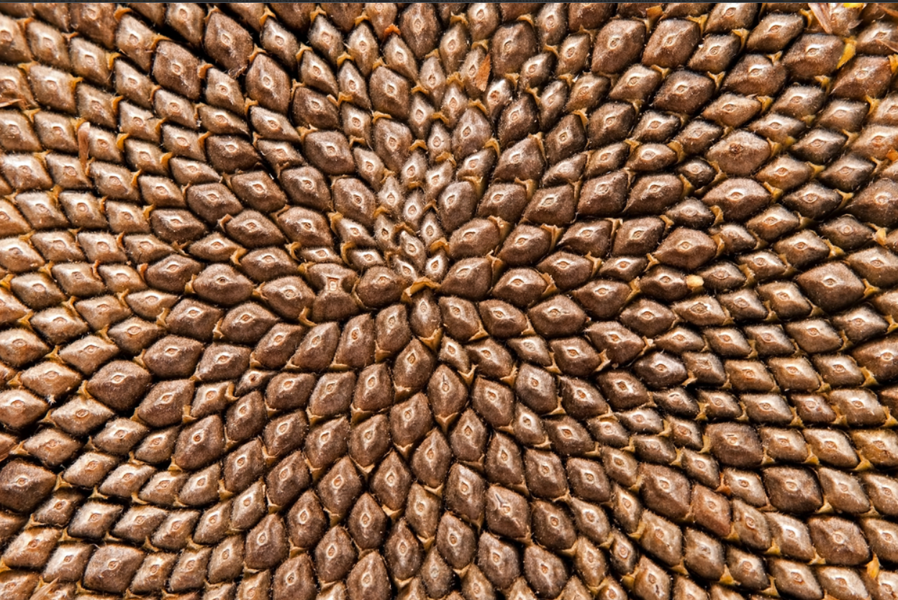
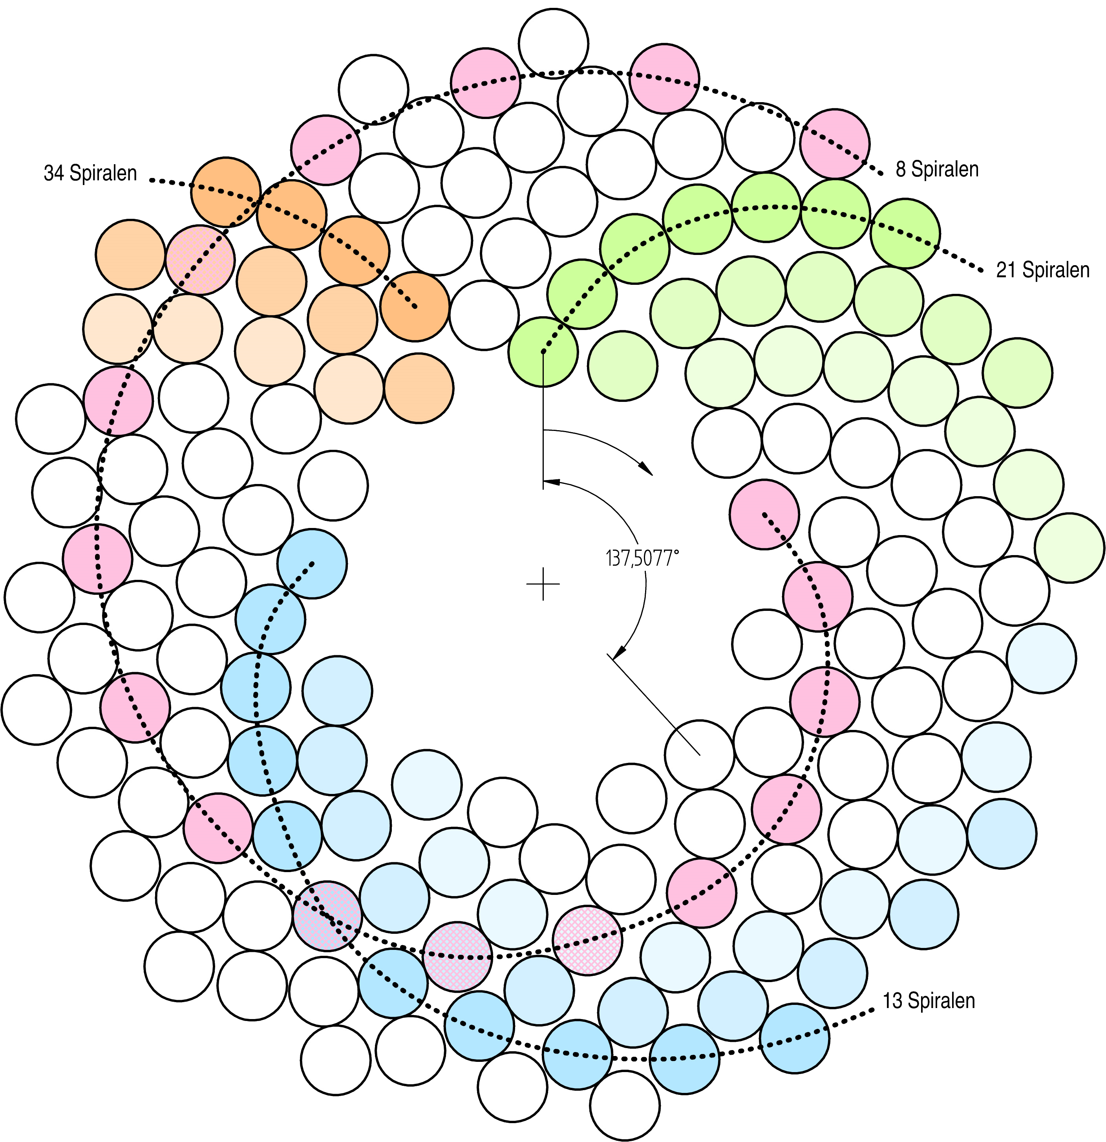
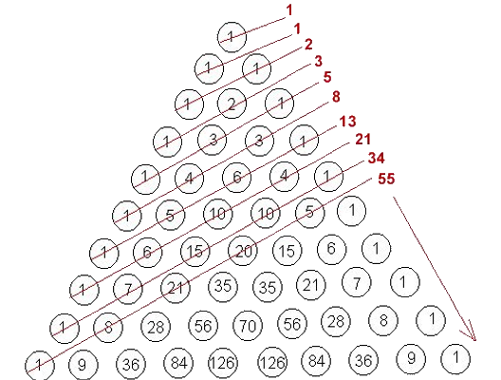
Golden Ratio in nature

Slide 11
Golden Ratio and Fibonacci
Dividing each Fibonacci number by the previous number gives: 1 / 1 = 1, 2 / 1 = 2, 3 / 2 = 1.5, and so on up to 144 / 89 = 1.6179….
The resulting sequence is:
1, 2, 1.5, 1.666..., 1.6, 1.625, 1.615…, 1.619…, 1.6176…, 1.6181…, 1.6179…
Do you notice anything about those numbers? Perhaps the fact that they keep oscillating around and getting tantalizingly closer and closer to 1.618?—the value of phi: the golden ratio!
Completely unbeknownst to Fibonacci, his solution to the rabbit population growth problem has a deep underlying connection to the golden ratio that artists and architects have used for thousands of years

Slide 12
Moral
Think about the natural numbers, or Fibonacci numbers, or prime numbers.. What is easier to remember?
All of these numbers as a distribution?
A generator formula?
We will see in class that viewing lots of data as a series of transformations, rather than a series of numbers, will help us analyze them and better mine them
That’s why you need to start thinking functional instead of Object-Oriented
We often visualize transformations with geometries… https://www.youtube.com/watch?v=xG63O03lWZI https://www.youtube.com/watch?v=nUN4NDVIfVI

